Slide 1

Console Bank Operations
Hitesh Lalwani

Slide 2
CONTENT
Python and it’s Implementation
Scope of Project
Class Design
Requirement Framing
Operating Environment
Summary of Application

Slide 3

Python
Python and it’s Implementation
Python is a high-level, fexible programming language that supports (OOP) principles, making it suitable for implementing various aspects of banking operations
Class Definitions : Like BankAccount class
Inheritence : BankAccount Class acts as a base class for SavingAccount and CurrentAccount class
Encapsulation : Current Balance is a private attribute
Polymorphism : Amount Withdraw in different classes works differently
Method Overiding : Withdraw and deposit method are override
It has several other purpose also

Slide 4
Scope of the Project
The Scope of the Banking System Project includes the following functionalities:
Account management (Create Account,Deposit Amount,Withdraw Amount) for Saving and Current Account.
Fund Transfer between Accounts.
Balance Inquiries

Slide 5
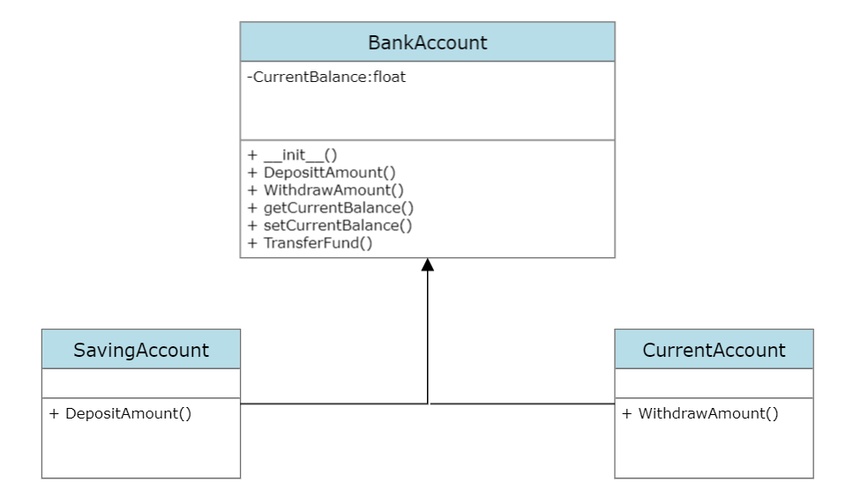
Class Design -Individual Classes

Slide 6
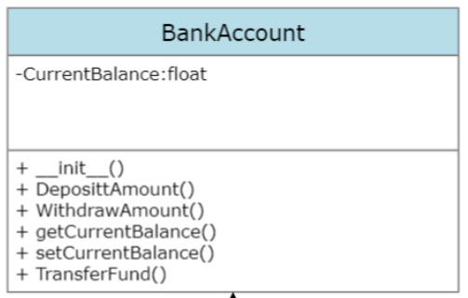
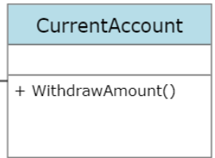
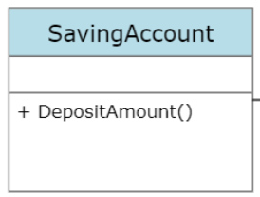
Class Design – On a Single Canvas

Slide 7
Functional Requirements of App

Slide 8
Requirement ID | Requirement CATEGORY | Requirement TYPE | PRIORITY | HIERARCHY | REF
R001 | FUNCTIONAL | STATED | High
Requirement DESCRIPTION | Create Account
SCOPE | Account is created at the time of creating bank object only
METHODOLOGICAL DETAILS of Requirement | Create a bank Account with some initial Balance it may be Saving Account or Current Account using constructor method

Slide 9
Requirement ID | Requirement CATEGORY | Requirement TYPE | PRIORITY | HIERARCHY | REF
R002 | FUNCTIONAL | STATED | HIGH
Requirement DESCRIPTION | Deposit Money
SCOPE | The method will be visible for the class objects that wants to deposit money.
METHODOLOGICAL DETAILS of Requirement | The money should be consistent through out the process Deposited money should be reflected in the corresponding account The methods should be reused. In case of Saving Account 3% interest will be given to customer for each deposit DepositAmount method will be created for this.

Slide 10
Requirement ID | Requirement CATEGORY | Requirement TYPE | PRIORITY | HIERARCHY | REF
R003 | FUNCTIONAL | STATED | HIGH
Requirement DESCRIPTION | Withdraw Money
SCOPE | The method will be visible for the class object that want to withdraw money.
METHODOLOGICAL DETAILS of Requirement | The money should be consistent through out the process Deposited money should be reflected in the corresponding account .The methods should be reused. Charge of 200 will be withdraw in each withdraw in case of Current Account WithdrawAmount method will be created for this.

Slide 11
Requirement ID | Requirement CATEGORY | Requirement TYPE | PRIORITY | HIERARCHY | REF
R004 | FUNCTIONAL | STATED | HIGH
Requirement DESCRIPTION | Transfer Money
SCOPE | The method will be visible for the class object that want to transfer money.
METHODOLOGICAL DETAILS of Requirement | The money should be consistent through out the process Transfer money should be reflected in the corresponding both the accounts. We will use deposit and withdraw function in case of transfer fund. TransferFund method will be created for this.

Slide 12
Requirement ID | Requirement CATEGORY | Requirement TYPE | PRIORITY | HIERARCHY | REF
R005 | FUNCTIONAL | STATED | MODERATE
Requirement DESCRIPTION | Check Balance
SCOPE | The method will be visible for the class object that want to Check Balance.
METHODOLOGICAL DETAILS of Requirement | Check Balance displays the Current Balance getCheckBalance method will be created for this.

Slide 13


OPERATING ENVIRONMENT
01
Windows
Ex:- pycharm
Or vs
Code
02
Mac_OS
Ex:- Pycharm
03
Linux
Ex:- EasyEclipse

Slide 14
Summary
The Project was effective in a place a user friendly system for bank operations, including balance enquiry, fund transfer, withdraw and deposit for both the account types i.e. Saving and Current Account.
Consistency of transaction data and effectiveness of the (OOP) principles were given top priority during the system design.
Future Changes will be necessary to adjust to changing user needs and technological advancements.

Slide 15
Thank you
Hitesh Lalwani (200686)
Service CTO

